Slide 1
BPMN - Business Process Modeling Notations
BPMN offers support for BP modeling by providing intuitive notations that are able to capture complex business rules and to establish a connection between design and implementation stages.
It is a graphical representation based on activity flows for defining business processes.
It represents a consensus between manufacturers of modeling tools that used proprietary notations.
BPMN offer a mechanism for executable business process generation (BPEL) from this graphical representation.
The business process modeled in BPMN can then be passed to a BPEL engine for execution, instead of being interpreted by a person or translated in other programming languages

Slide 2
BPMN– basic elements(1)
Flow objects represent the main elements of process diagrams. They fall into one of the following categories:
Event,
Activity,
Gateway.
Connecting objects have the role of connecting object flows with each other or with other object types. There are three types of connecting objects:
Sequence flow,
Message flow and
Association.
Swimlanes – They set subgraphs in the process flow in order to logically separate some parts of it, depending on the entities involved in carrying out the process. There are two types:
Pool and
Lane.

Slide 3
BPMN– basic elements(2)
Data are necessary to show data needed in activities or resulted from activities. They fall into four categories:
Data object,
Data input,
Data output and
Data store.
Artifacts - they provide additional information about how documents, data, and other objects are used and updated within a Process. There are two types of standard artifacts:
Group and
Annotation,
but both language and modeling tools provide option of adding any other custom user artifacts necessary to understand the model.

Slide 4
BPMN– basic elements(3)

Slide 5
Flow objects
Flow objects are the main describing elements within BPMN, and consist of three core elements:
Activity - An activity is a generic term for work that a company performs. It can be atomic (task) or compound (sub-process). It is represented with a rounded-corner rectangle.
Event: it denotes something that happens (compared with an activity, which is something that is done). Icons within the circle denote the type of event. They impact the model flow and ususally have a cause (trigger) and an effect (result). There are three event types, considering the moment they impact the process flow:
Start Intermediate End
Gateways: thay are modeling elements that determines forking and merging of paths, depending on the conditions expressed. They are considered decision elements and are represented with a diamond shape.
Task
Sub-Process
+
Notes:
https://www.slideshare.net/PeterREgli/business-processing-modeling-notation-bpmn

Slide 6
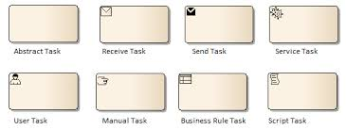
A task represents a single unit of work that is not or cannot be broken down to a further level of business process detail.
Abtract task – task without any specialization
Receive task – task that waits for a message to arrive from an external participant. After the message is reveived, that task is completed.
Send task – task for sending a message to an external participant. After the message is send, that task is completed.
Service task – task that uses some sort of service, like a web service.
User task – task executed by a human with the assistance of a software application
Manual task – task executed by a human without the assistance of any process execution engine or application.
Business rule task – Provides input to a business rule engine. Reveives output from a business rule engine.
Script task –It is executed by a business process execution engine. When the task is finished.

Slide 7
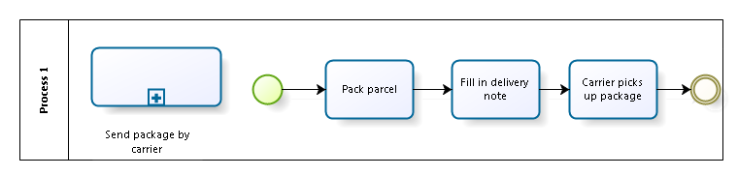
Sub-processes
They are compound activities included in a process.
They can be hierarchically nested to any level of detail that is necessary to fully describe a process.
A sub-process can be collapsed or expanded to show or hide its details
Each expended description of a sub-process must include start and end events which do not specify a particular behavior.

Slide 8
Event categories
1. Start event that receives a message.
2. Intermediate event that receives a message.
3. Intermediate event that sends a message.
4. End event which that a message.
5. Start event that receives a message without interrupting another activity.
6. Intermediate event that receives a message without interrupting another activity.

Slide 9
Event qualifiers

Slide 10
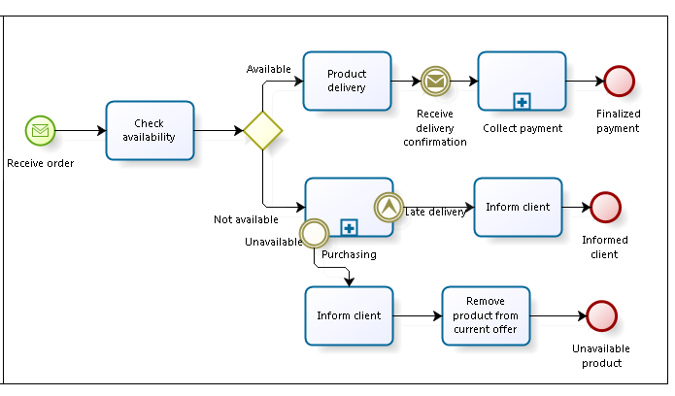
Events - exemple

Slide 11
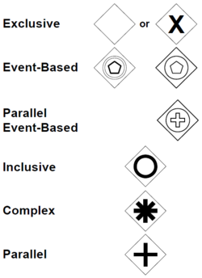
Gateway types

Slide 12
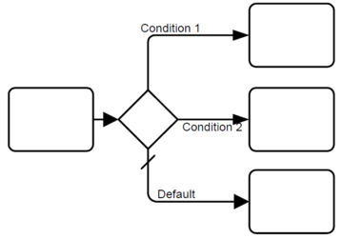
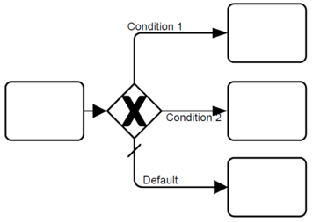
Exclusive gateways
They are also called Decisions and are used to create alternative paths within a Process flow
Only one of the paths can be taken, this means the gateway is exclusive
A Decision can be thought of as a question that is asked at a particular point in the Process
The question has a defined set of alternative answers (condition Expression)

Slide 13
Inclusive gateways
It can be used to create alternative but also parallel paths within a Process flow
All condition Expressions are evaluated; the true evaluation of one condition Expression does not exclude the evaluation of other condition Expressions
Since each path is considered to be independent, all combinations of the paths MAY be taken, from zero to all
However, it should be designed so that at least one path is taken.

Slide 14
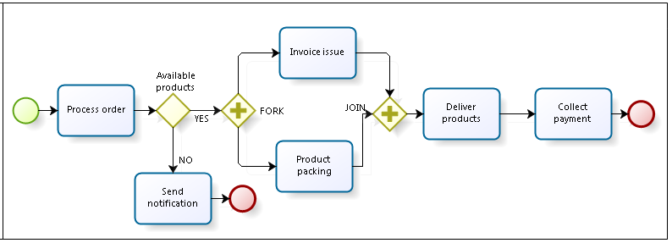
Parallel gateways
A Parallel Gateway is used to synchronize (combine) parallel flows and to create parallel flows
A Parallel Gateway creates parallel paths without checking any conditions
For incoming flows, the Parallel Gateway will wait for all incoming flows before triggering the flow through its outgoing Sequence Flows

Slide 15
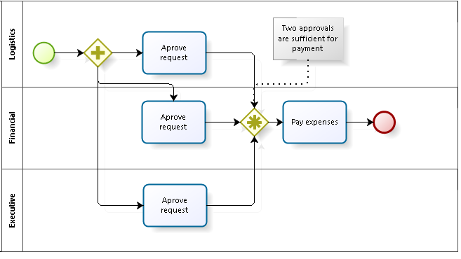
Complex gateways
The Complex Gateway can be used to model complex synchronization behavior. An Expression is used to describe the precise behavior.
For example, this Expression could specify that tokens on three out of five incoming Sequence Flows are needed to activate the Gateway
What tokens are produced by the Gateway is determined by conditions on the outgoing Sequence Flows as in the split behavior of the InclusiveGateway

Slide 16
Event-based gateways
The Event-Based Gateway represents a branching point in the Process where the alternative paths that follow the Gateway are based on Events that occur
A specific Event, usually the receipt of a Message, determines the path that will be taken
Basically, the decision is made by another Participant, based on data that is not visible to Process, thus, requiring the use of the Event-Based Gateway.

Slide 17
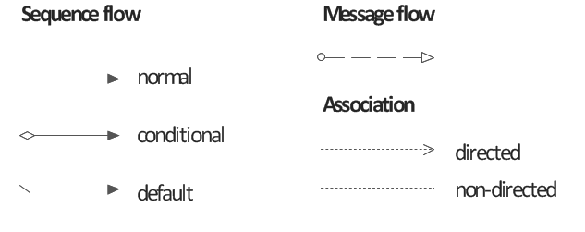
2. Connecting objects
Sequence flow is used to connect flow elements. It shows the order of flow elements.
In BPMN, the communication between pools is achieved by the use of message. Message flow is used to show the flow of messages between pools or flow elements between pools.
A data association shows the information flow between activities of a business process.
An association links artefacts with other BPMN graphical elements
Notes:
https://training-course-material.com/training/BPMN_2.0_Gateways#Complex_Gateway

Slide 18
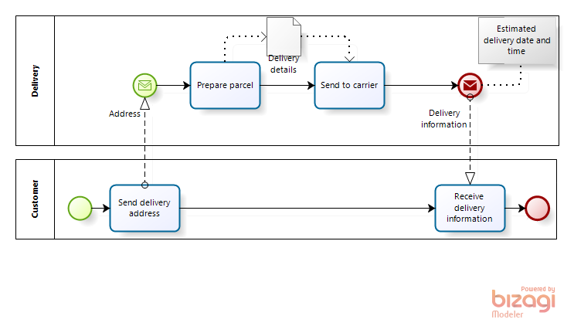
Exemple of connecting objects

Slide 19
Sequence flows
They can connect following elements: events (start, intermediate and end events), actions, sub-processes and gateways.
Limitations of a sequence flow:
It cannot represent an entry for a start event;
It cannot represent an exit for an end event;
It cannot directly connect an action of a process with an action of a sub-process; the link must be correctly established between action and sub-process.
It is allowed only within a pool; for interactions between pools, message flows must be used.
It cannot be used to connect artefacts to other modeling elements; association must be used.
It can be replaced by intermediate link events, but both intermediate link events must belong to the same pool.

Slide 20
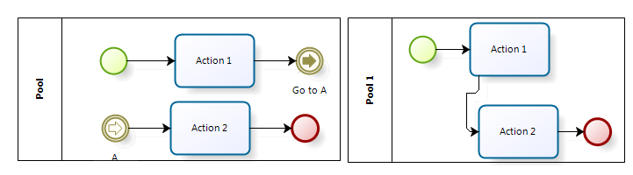
Link events– example

Slide 21
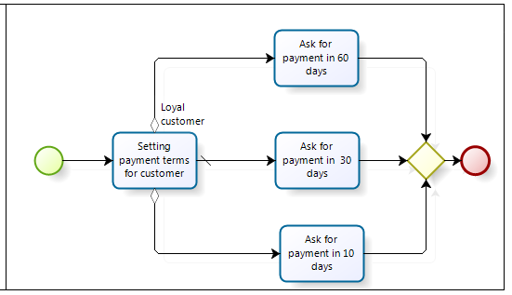
Conditional sequence flows
A sequence flow can define a condition when connecting an inclusive or an exclusive gateway or a task; it will be called conditional sequence flow.
It is an alternative way to represent branching and merging without the usage of gateways
When using conditional flows we must pay attention to the set of conditions represented by the outgoing flows: they have to lead to a valid result for each time the task is executed.

Slide 22
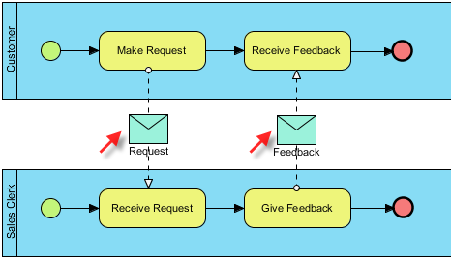
Message flows
A message flow is used to show message exchange between two participants that are prepared to send and receive messages. In BPMN, this two participants will be represented by two separate pools within a collaboration diagram.
Optionally, message flows can be extended with a message object, that will be associated with the message flow or overlapping the message flow. Message objects explicitly describe the communication content exchanged between the two participants.

Slide 23
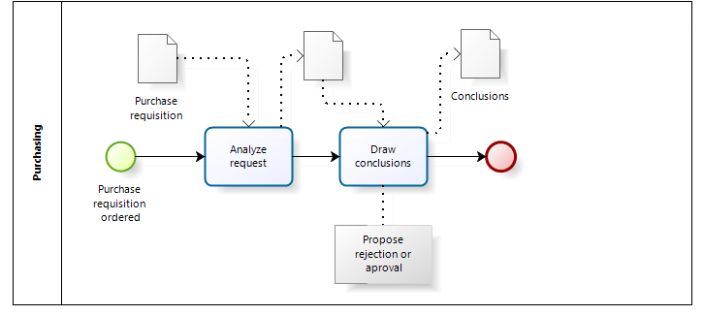
Data associations
To represent a process data flows, BPMN uses data association = a bidirectional association. Data associations are used for transferring data between processes or tasks.
They have no effect on the process task flow, but to show what data a process or task needs and/or produce.

Slide 24
3. Partitioning objects
Represent a mechanism to organize activities into separate visual categories in order to highlight different functional capabilities or responsibilities.
Pool: represents a participant in the process. It involves organizational units or physically separated participants.
Lane: used to organize and share activities. They are placed inside a container and may be nested.

Slide 25
Participants
A participant is an entity identified in the business model, who performs or has certain responsibilities in executing activities in a process and acts as a participant in a collaboration.
From the perspective of BPMN language, a participant is visually represented in the form of a container (pool) BPMN specification distinguishing between two levels of participation :
organizational unit, representing an internal or external interest group of the organization, such as the company or a department;
Role associated to the execution of an activity such as client, supplier, producer etc.

Slide 26
Sequence and message flows
A container encapsulates a sequence of activities from a process, which means that the sequence flows can not cross the boundaries of a container.
The container name does not necessarily mean an organizational unit, it can specify the name of the process itself, such as "Product Reception" or "Request repair“.

